Slide 1

DIAMOND PRICE PREDICTION
ANJALI YADAV ATHARVA AGRAWAL
DHANUSH GOWDA HARSHAD BANDI
KARTHIK M K YESHPAL SINGH
18-NOVEMBER-2022
This Photo by Unknown Author is licensed under CC BY

Slide 2
Project analysis slide 2
INDEX
PROBLEM STATEMENT
FEATURES
REGRESSION
METHODOLOGY
RESULTS
CONCLUSION

Slide 3
PROBLEM STATEMENT
We have datapoints for 53,940 across 10 features of diamonds. In this supervised model we have been provided with the target column which is the Price of the diamond. The goal is to predict the price of Diamond using different Regression Algorithms.

Slide 4
FEATURES
CARAT
Unit of weight for Diamond
CUT
The cut type of the Diamond, it determines the shine
COLOR
Hue of a Diamond based on the GIA’s color scale
CLARITY
Visual appearance of Diamond in qualitative metrics

Slide 5
DEPTH
The value of how deep or shallow the Diamond is
TABLE
LENGTH
Length of the Diamond
HEIGHT
WIDTH
Width of Diamond
Height of Diamond
The flat surface on very top of the stone

Slide 6
METHODOLOGY
DATA COLLECTION
EDA
MODELS
PREDICTIONS

Slide 7
DATA COLLECTION
The Diamond price prediction data chosen for this project is taken from Kaggle. We used pandas read_csv() function to load the data to the notebook. This dataset comes with both categorical and numerical data which has been cleaned and processed to build the model.
Source : Data_Source

Slide 8
EXPLORATORY DATA ANALYSIS
Missing value treatment : We used isnull() function on our dataset to find the missing values.
Outlier treatment : We checked the outliers in the data through boxplot.
Linearity : We checked the data linearity through Pairplot.
Normality : We used Displot to find the normality of target variable.
Count : We used value_counts() to get the count of attributes
Numerical data conversion : We used LabelEncoder to convert the categorical columns to numerical data.

Slide 9
MODEL BUILDING
We divided the data as train and test set using train_test_split() function.
We imported the required libraries for the models used
Models built were:
Linear Regression
OLS
Decision Tree
Random Forest
Models were evaluated using r2_score

Slide 10
PREDICTIONS
We have tabulated the result metrics of each model
We have compared first 10 points of target column price and compared it with model predictions.

Slide 11
RESULTS

Slide 12
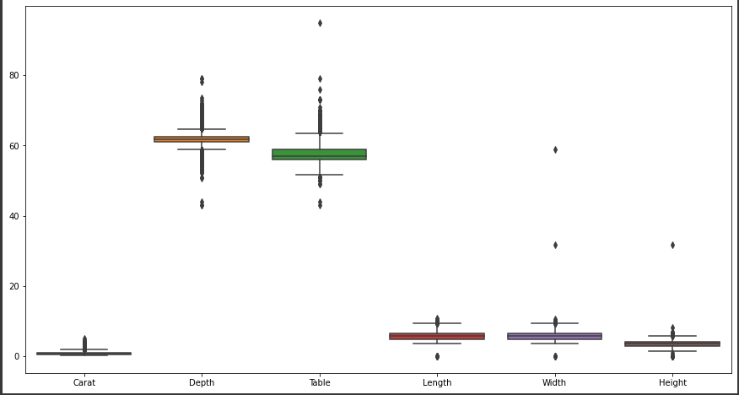
EDA
The Dataset did not contain any missing values.
Even though the boxplot shows many outliers we have taken the data as it is for the model building, as the diamond features may vary with different types.
We have converted categorical columns into numerical using LabelEncoder

Slide 13
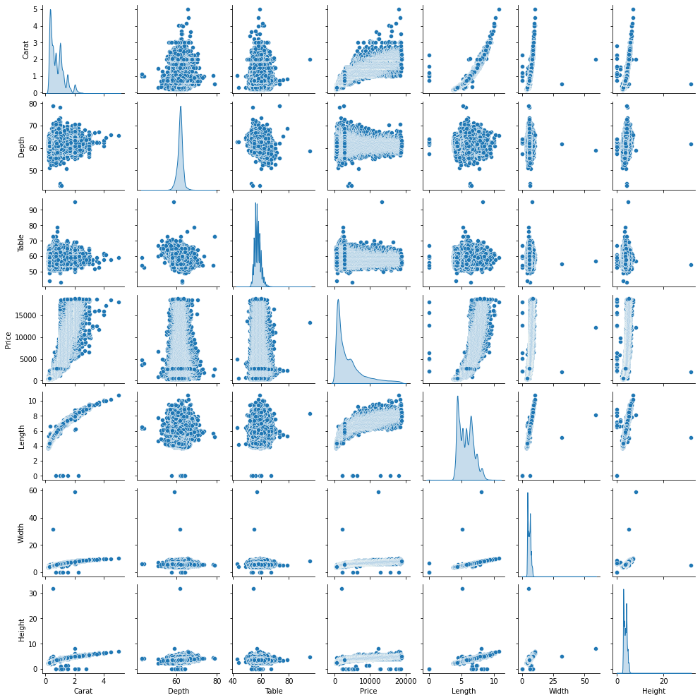
4. From the below pair plot we can say that the data is linear

Slide 14
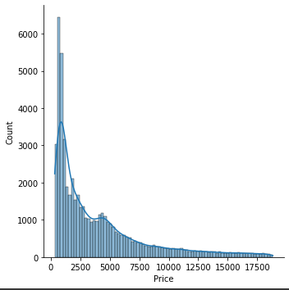
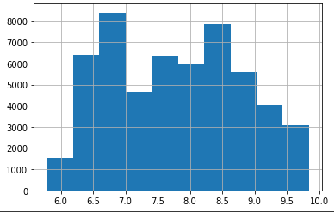
Before logging
After logging
5 . We transferred target column price from skewed data to normal data

Slide 15
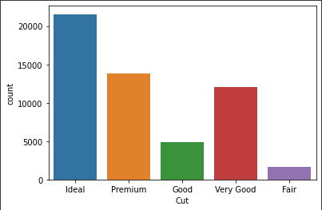
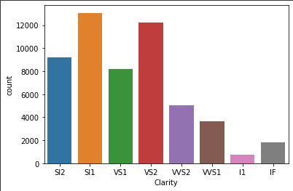
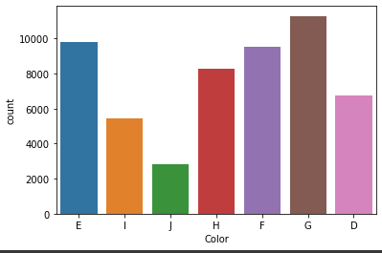
6. Counts of Categorical columns
In the cut feature of Diamond Ideal cut has highest value count with 21551
In the color feature of Diamond G type has highest count with 11292
The clarity feature of diamond has SI1 type with highest count of 13065

Slide 16
Models
We have built 4 regression models i.e., Linear Regression, OLS, Decision Tree, Random Forest

Slide 17
Predictions
We can observe the predictions of 1st 10 data points in the linear graph shown below

Slide 18
CONCLUSION
53,940 data points from 10 columns have been processed to build the regression models.
Ideal cut of diamonds are used or sold more in the market
G colored diamonds are more frequent
Diamond with SI1 clarity have appeared more in the dataset
With 99.88% r2_score we can conclude that Random Forest Regressor give the best model.
We have taken 10 prices from each model and compared it to actual prices. Even though random forest is displaying varied prices in the 1st 10 points, it has very low error rate when processed through 50 odd thousand data points.

Slide 19

THANK YOU

